Slide 1
Principles of Economics
Topic 2 (Chapter 24)
Measuring the Cost of Living – Consumer Price Index (CPI)

Slide 2
Economic Models
Economists use models to simplify reality in order to improve our understanding of the world.
The most basic macroeconomic model include:
  The Circular Flow Diagram

Slide 3

Figure 1 The Circular-Flow Diagram
MARKETS
Revenue
FOR
Spending
GOODS AND SERVICES
Goods
Firms sell
Goods and
and services
Households buy
services
sold
bought
FIRMS
HOUSEHOLDS
Produce and sell
Buy and consume
goods and services
goods and services
Hire and use factors
Own and sell factors
of production
of production
Factors of
MARKETS
Labor, land,
production
FOR
and capital
FACTORS OF PRODUCTION
Wages, rent,
Households sell
Income
and profit
Firms buy
= Flow of inputs
and outputs
= Flow of money
Copyright © 2004 South-Western

Slide 4
The Circular-Flow Diagram
The circular-flow diagram is a visual model of the economy that shows how money flow through markets among households and firms.

Slide 5
THE CONSUMER PRICE INDEX
The consumer price index (CPI) is a measure of the overall cost of the goods and services bought by a typical consumer.
CPI is used to monitor changes in the cost of living over time.

Slide 6
THE CONSUMER PRICE INDEX
When the CPI rises, the typical family has to spend more money to maintain the same standard of living.

Slide 7
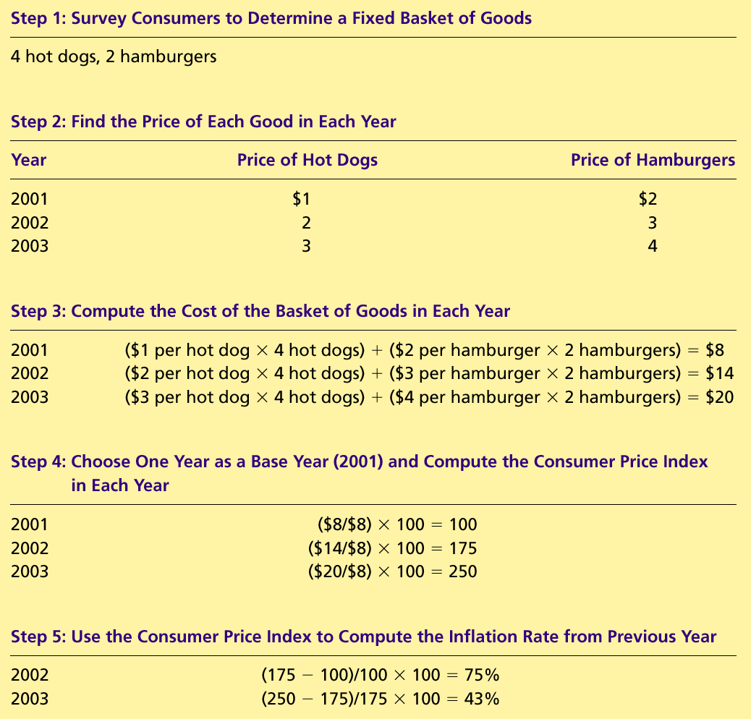
How the Consumer Price Index Is Calculated
Fix the Basket: Determine what prices are most important to the typical consumer.
  The Economic Agency identifies a basket of goods and services the typical consumer buys.

Slide 8
How the Consumer Price Index Is Calculated
Find the Prices: Find the prices of each of the goods and services in the basket for each point in time.

Slide 9
How the Consumer Price Index Is Calculated
Compute the Basket’s Cost: Use the data on prices to calculate the cost of the basket of goods and services at different times.

Slide 10
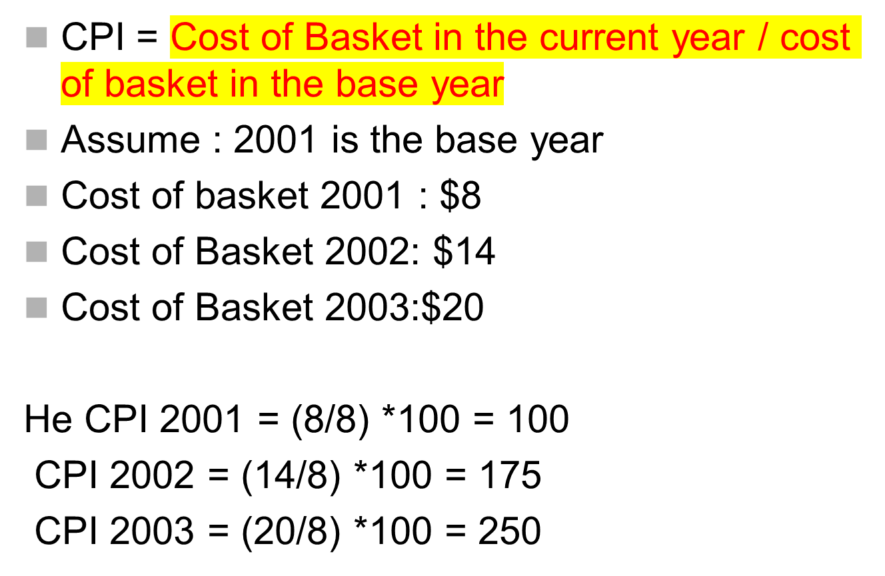

Slide 11
How the Consumer Price Index Is Calculated
Choose a Base Year and Compute the Index:
  Designate one year as the base year, making it the benchmark against which other years are compared.
  Compute the index by dividing the price of the basket in one year by the price in the base year and multiplying by 100.

Slide 12
How the Consumer Price Index Is Calculated
Compute the inflation rate: The inflation rate is the percentage change in the price index from the preceding period.

Slide 13
How the Consumer Price Index Is Calculated
The Inflation Rate
  The inflation rate is calculated as follows:

Slide 14
CPI Vs GDP deflator
GDP deflator & CPI give some what different information about what’s happening to the overall level of prices in the economy.
Three Key Differences:
GDP deflator measures the prices of all goods and services produced
whereas CPI measures the prices of only the goods and services bought by consumers
GDP deflator includes only those goods produced domestically. Imported goods are not a part of GDP and do not show up in the GDP deflator.
CPI include imported goods.
3. CPI is computed using a fixed basket of goods whereas GDP deflator allows the basket of goods to change over time as the composition of goods and services changed

Slide 15
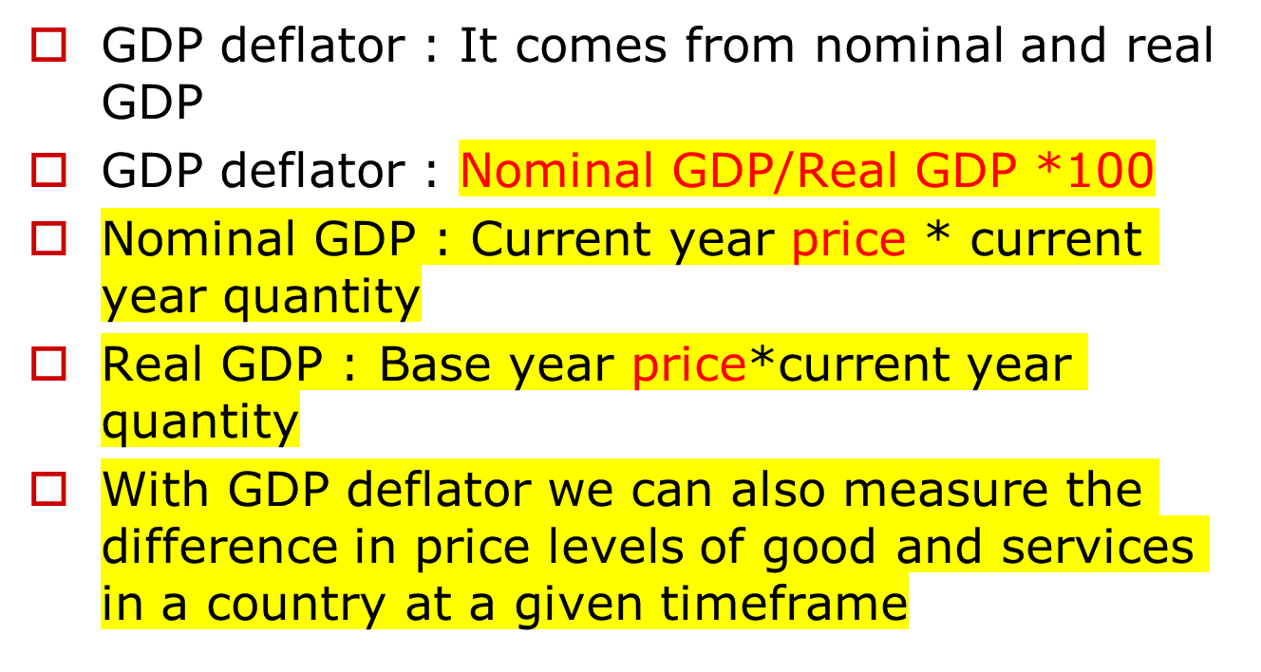

Slide 16
Problems in Measuring the Cost of Living
The CPI is an accurate measure of the selected goods that make up the typical bundle, but it is not a perfect measure of the cost of living.

Slide 17
Problems in Measuring the Cost of Living
Substitution bias
Introduction of new goods

Slide 18
Problems in Measuring the Cost of Living
Substitution Bias
  The basket does not change to reflect consumer reaction to changes in relative prices.
    Consumers substitute toward goods that have become relatively less expensive.
    The index overstates the increase in cost of living by not considering consumer substitution.

Slide 19
Problems in Measuring the Cost of Living
Introduction of New Goods
  The basket does not reflect the change in purchasing power brought on by the introduction of new products.
    New products result in greater variety, which in turn makes each dollar more valuable.
    Consumers need fewer dollars to maintain any given standard of living.

Slide 20
Problems in Measuring the Cost of Living
The substitution bias, introduction of new goods, cause the CPI to overstate the true cost of living.
  The issue is important because many government programs use the CPI to adjust for changes in the overall level of prices.

Slide 21
Summary
The consumer price index shows the cost of a basket of goods and services relative to the cost of the same basket in the base year.
The index is used to measure the overall level of prices in the economy.
The percentage change in the CPI measures the inflation rate.

Slide 22
Summary
The consumer price index is an imperfect measure of the cost of living for the following three reasons: substitution bias, and the introduction of new goods.

